Slide 1

Testing
Henry Tang
hktang@ualberta.ca
Department of Computing Science
University of Alberta
CMPUT 301 – Introduction to Software Engineering
Slides adapted from Dr. Hazel Campbell, Dr. Ken Wong, and Dr. Abram Hindle
Updated by Michelle Deng [2026]
Images reproduced in these slides have been included under section 29 of the Copyright Act, as fair dealing for research, private study, criticism, or review. Further distribution or uses may infringe copyright.

Slide 2
Table of Contents
Why do we test?
Testing Methodologies
  Test-Driven Development
  State-based Testing
  Black Box Testing
Testing Strategies
Design for Testing
  Dependency Injection
  Mock Object

Slide 3
Why do we test?
Notes:
Ask this question to the class

Slide 4
Software Defects
Some terms:
  Human errors can lead to faults in work products, which may cause failures when running the software
  Can try to find faults through testing, reviews, proof, model checking, code analysis, etc.
  Some avoid the term bug, since it implies something wandered into the code
Notes:
development produces system features and defects (waste product)
sometimes two fault may interact
- works fine if both are present, but fails if one is fixed

Slide 5
Examples of Defects
Actual behavior differing from expected:
  Algorithmic
    Code logic does not produce the proper output
  Overload
    Data structure unexpectedly filled completely
  Performance
    Violates service level agreement
  Accuracy
    Calculated result not to the desired level of accuracy
  Timing
    Race condition in coordinating concurrent processes
Notes:
Google Apps SLA
99.9% uptime (percentage of minutes in a month that the system is available)
45 minutes down per month
accuracy
computer numbers and math
adding the number 0.1 to itself ten times, you don’t get 1 back
decimal number 0.1 is repeating fraction in binary 0.00011
what if dealing with currency values
use integral values like pennies when dealing with currency values (or special data type, like BigDecimal)
problem when testing with numbers
suppose s contains sum of adding 0.1 ten times
assert that s == 1, fails
print s, shows 1
timing
processes or threads accessing a shared resource
race condition where the outcome depends on the order in which access is made
works sometimes but not always
deadlock
mutual exclusion
hold and wait
no preemption
circular wait

Slide 6
Failure
AT&T failure (1990):
  114 switching nodes of their long-distance system crashed
  The outage lasted for 9 h, 70 million calls went uncompleted
Reason:
  If a node crashes, it tells neighboring nodes to reroute traffic around it
  A bug in handling this message caused the receiving node to also crash, etc.
Notes:
cascading problem
Skype

Slide 7
Fault in Code
Root cause:
  do {
  switch (…) {
  case …:
  if (…) {
  …
  break;
  } else {
  …
  }
  …
  }
  } while (…);
After expensive testing phase, a small change was made without again retesting
Notes:
what happens?
another cause
programmer misunderstanding
top bugs
Y2k date problem
conversion of metric to imperial units
buffer overrun and divide by zero to stop a military ship
Ariane 5, reused code and overflow error, destruction of rocket and 4 uninsured satellites

Slide 8
Goal
Does program P obey specification S?
  What is P?
  What is S?
Notes:
obeys or not obeys
difficult even if P and S are precisely and formally stated in mathematics

Slide 9
Why Test?
Goals:
  Verification
    Check that requirements are satisfied
  Not only to confirm normal behavior
    Find problems to refute that the program is correct
  Establish due diligence
    Evidence in case of product liability litigation
  Avoid regression
    Prevent previous problems from reoccurring
Notes:
confirm
not wrong per se, just incomplete
imagine your program is a scientific theory (about the solution)
it should be falsifiable (testable)
work hard to show it does not work
testing may be adversarial
independent testing teams in game companies
relish at breaking the developer’s code
testing may be collaborative
developers also write and do tests (rather than tossing code over the fence to the testing team)
developers make the code easy to test (advised by testers)
testers write code that make it easy for developers and testers to write tests

Slide 10
Regression Testing
Goal:
  To avoid breaking things that should work
    Collect, reuse, and re-run automated test cases
  Do regression test after a change or fix
    Re-run tests to check whether previously passing tests of the system now fail
    E.g., old defect somehow became unfixed
Notes:
progress, not regress
previously, after fixing old defect, you wrote a test and ran it to show the fix worked
- but now, after some other change, this test fails
reason for previous test failing
- could be an issue with the code or an issue with a test

Slide 11
Approaches
Reasoning about the state model for P:
  Typically, a huge number of states
  Every practical technique must be inaccurate
  Could abstract states
  Could sample states
  Or both
Notes:
relating requirements, state diagrams (state models), and testing
combinatorial explosion of states
abstract
subset of variables or subset of values

Slide 12
Approaches
Abstraction:
  Often used in static software analysis techniques
    E.g., model checking P for some specific S
  Techniques often pessimistically inaccurate
    May report P is faulty when P is correct
Notes:
average developer and CS graduate these days is not aware of general model checkers
but use specific ones often found in compilers, like type checking
high recall, tends to find the fault
S specifies no uninitialized data is used
says P is faulty when it isn’t
false positive on detecting a fault
says P is not faulty when it is
false negative on detecting a fault
ultimately, discuss testing now, so we can design our code to be easier to test
cannot easily sprinkle in testing after the fact

Slide 13
Approaches
Sampling:
  Often used in dynamic analysis techniques
    E.g., testing, profiling
  Techniques often optimistically inaccurate
    May report P is correct when P is faulty
    Testing drives P through a sampling of states, but the samples may not generalize to actual situations
Notes:
high precision

Slide 14
Testing Techniques
Creating good tests:
  Test every error message
    Error-handling code tends to be weaker
  Test under other configurations
    Programmers are biased to their own setup
Notes:
Test all possible paths
Test MacOS/Windows/Linux, Laptop/Desktop/Mobile, etc

Slide 15
Limits of Testing
Issues:
  A program cannot be tested completely
    Too many inputs and path combinations to cover
  Testing cannot find all defects
    Cannot show their absence, just their presence
  Challenging
    Testing may be expensive and frustrating
    Test code itself could add its own defects
Notes:
statement coverage is still not enough
cannot show correctness through testing
lots of different platforms and configurations
testing may not earn popularity points
so why do it?

Slide 16
Test-Driven Development

Slide 17
Automated Testing
Purpose:
  Write software to help test software
    Automation essential to test-driven development and refactoring
Limitations:
  Manual testing still need to observe certain problems
    E.g., strange noises from the speaker, flickering graphics

Slide 18
Automated Testing
A good automated unit test:
  Is simple to write and understand
    Reduces the chance of defects in the test code
  Runs quickly
    Allows it to be re-run frequently while developing
  Is isolated
    Could run multiple unit tests in parallel
  Shows exactly what went wrong if it fails
    Reduce time spent in a debugger
Notes:
unit testing
state-based testing
effective for low-level units
has a nice story
does not eliminate end-to-end testing
large scale behavior, configuration, assembly

Slide 19
Automated Testing
“Whenever you are tempted to type something into a print statement or a debugger expression, write it as a test instead.”
— Martin Fowler

Slide 20
Test-Driven Development
Idea:
  If testing is so useful, let’s write the tests first
  These automated tests capture code-level requirements to be satisfied
  Once code is written so that these tests pass, then these requirements are met
Notes:
approach used in agile development and extreme programming
unlike user requirements, these tests are a form of executable requirements, which is nice

Slide 21
Traditional development
Write method interface
Write method body
Write automated tests
Run automated tests
Adjust method and re-test until tests pass
Notes:
because the method is written first, and possibly class written first, can lead to code that is hard to test or a class that is hard to use

Slide 22
Test-first or test-driven development
Write automated tests
Run automated tests
← Should fail!
Write method interface and stub
Run automated tests
Write method body
Run automated tests
Adjust method and re-test until tests pass
Notes:
write the test first
force you to think how the method (or class) should be used
then design a nice API
ultimately leads to cleaner code
failed test
won’t even compile, you get compiler feedback on what is needed
failed test
no functionality
unexpected if it were to pass

Slide 23
State-Based Testing

Slide 24
State-Based Testing
Steps:
  Set up software into a known state
    E.g., initialize variables
  Trigger transitions to cause state changes
    E.g., call methods to change variables
    E.g., interact with the user interface
  Verify the actual arrived state is expected
    E.g., see if actual values in variables meet expectations
Notes:
just one kind of testing
start the software
interact with it
see if feedback is what you expect
- witness effects

Slide 25
Black Box Testing

Slide 26
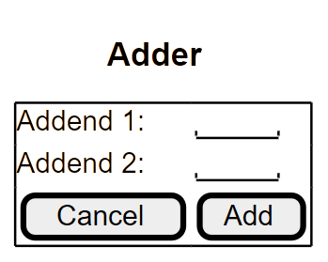
Black Box Testing
Testing, without seeing the code:

Slide 27
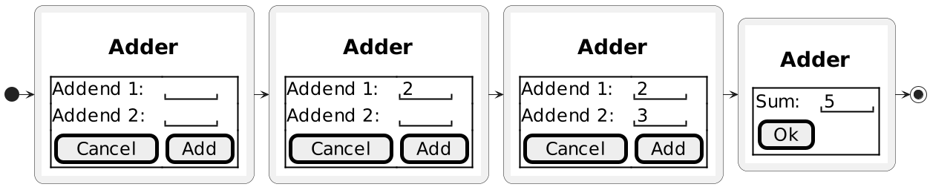
Black Box Testing
Expected behavior:
  Deviations from the expected interaction?
Notes:
deviations
- pressing add before fully entering both numbers
- entering the second number first
- long numbers

Slide 28
Black Box Testing
Tips:
  Want be systematic about what to test
    E.g., focus on the adder functionality for now
  Avoid redundant tests
    Too easy to keep adding meaningless extra tests
  Determine equivalence classes of tests
Notes:
thinking you’re doing lots of tests, but not really
discrete math notion of partitioning a set
consider the set of all possible tests
equivalence class
not about object-oriented classes here
find as many equivalence classes a possible

Slide 29
Black Box Testing
Equivalence classes:
  Each test inside an equivalence class checks the “same thing”
  If a test inside the class will catch a defect, the other tests probably also will
  If a test inside the class will not catch a defect, the other tests probably also will not
  Keep only a few tests in each class, as representatives

Slide 30
Equivalence Classes
Partitioning of test cases

Slide 31
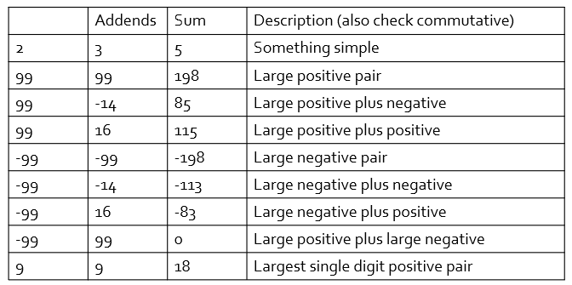
Black Box Testing
Example test cases:
  Be systematic about what to test, not knowing the internal code

Slide 32
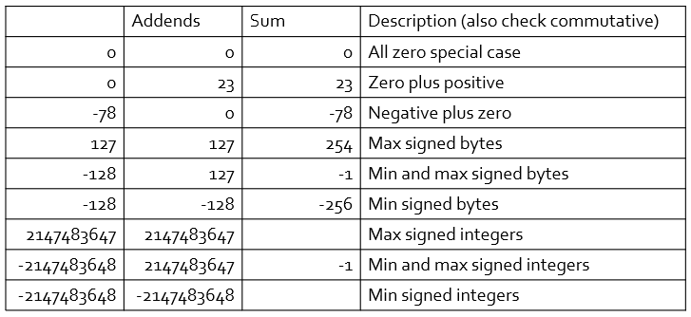
Black Box Testing
Example test cases:
  Guessing at internal algorithm or representation
Notes:
testing at and around boundary values
- might reveal ambiguities in the requirements

Slide 33
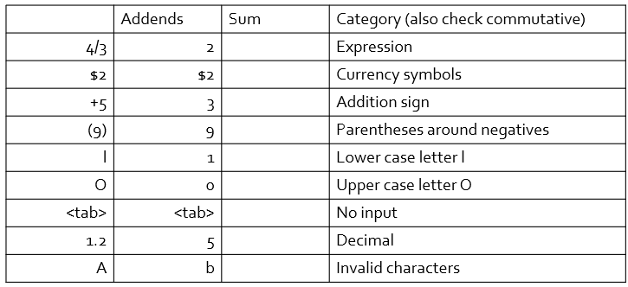
Black Box Testing
Example test cases:
  Data input from fields in user interface

Slide 34
Black Box Testing
Example test cases:
  And even more user interface explorations
    Editing with delete, backspace, cursor keys, etc.
    Using F1, escape, and control characters
    Vary timing of data entry
Notes:
data entry timing
- cause of one issue in the Therac 25 accident (radiation therapy machine, radiation overdose that killed people)
- X (erroneously), cursor up, E (correct), enter, within 8 seconds to cause failure

Slide 35
Testing Strategies

Slide 36
Testing Strategies
Big-bang strategy:
  Test thoroughly only after the whole system is put together
  Pro(?)
    “Project almost finished, only testing left”
  Cons
    Hard to pinpoint the cause of a failure
Notes:
also bad arguments and feelings when things fail

Slide 37
Testing Strategies
Top-down incremental strategy:
  Implement/test the highest-level modules first
    Provide stubs for lower-level functionality not yet implemented
    Higher-level modules are the test drivers
Bottom-up incremental strategy:
  Implement/test the lowest-level modules first
    Need to write test drivers
Notes:
bottom-up
test units individually
focus on unit testing in this course
combine approaches

Slide 38
Design for Testing
Notes:
good design and good testing
somewhat at odds
high abstraction can often make things hard to test (hard to find and fix defects)

Slide 39
Good Software Design
Software should be flexible:
  Easy to change to respond to new needs
  Easy to understand
  Easy to extend, without exploding complexity
Software should be testable:
  Easy to construct the units
  Easy to set up units into desired state
  Easy to drive code and witness effects
Software design techniques: Dependency Injection, Mock Objects
Notes:
designing software to be flexible and designing software to be testable can go hand in hand
what makes software inflexible and hard to test?
- blob class

Slide 40
Dependency Injection
Notes:
Credit: https://medium.com/@mahbooberezaee68/dependency-injection-in-kotlin-b0e2dc3bd842
Manual DI is covered, but there’s DI Frameworks that automate DI processes, which is helpful for larger projects

Slide 41
Dependency Injection
Used to reduce high coupling (lots of dependencies between classes)
Done by providing required objects from an external source instead of creating them inside the class
Allows classes to depend on abstractions or interfaces rather than specific implementations
Notes:
James Shore calls this a $25 name for a 5 cent concept
- by itself, simple, but huge effect on a system if it is applied nearly everywhere
handy for isolating classes during testing
- canned data source object
could have a setter method to form the dependency rather than in the constructor
might have a design to standardize the name of this setter method
might have a tool to generate these dependencies based on some dependency description language
DataSource here could be a superclass or interface type

Slide 42
Dependency Injection Example
class Wand {
fun shoot() {
// do something
}
}
class Wizard {
val wand = Wand()
fun castSpell() {
wand.shoot()
}
}
NO Dependency Injection
Suppose the wands instantiated from the Wand class can only shoot fire
What if we wanted to shoot ice?
We can’t since the Wizard class creates a specific implementation of the Wand Class

Slide 43
Dependency Injection Example
class Wand {
fun shoot() {
// do something
}
}
class Wizard {
val wand = Wand()
fun castSpell() {
wand.shoot()
}
}
NO Dependency Injection
Problems:
Difficult to test
Difficult to change implementation
Reduced Reusability

Slide 44
Dependency Injection Example
WITH Dependency Injection
class IceWand : Wand
override fun shoot() {
// do something else
}
}
class Wizard(private val wand: Wand) {
fun castSpell() {
wand.shoot()
}
}
interface Wand {
fun shoot()
}
class FireWand : Wand {
override fun shoot() {
// do something
}
}

Slide 45
Dependency Injection Example
interface Wand {
fun shoot()
}
class FireWand : Wand { // concrete implementation
override fun shoot() {
// do something
}
}
class IceWand : Wand
override fun shoot() { // another concrete implementation
// do something else
}
}
class Wizard(private val wand: Wand) { // inject Wand
fun castSpell() {
wand.shoot()
}
}
WITH Dependency Injection
We inject wand as a parameter for the Wizard class to allow for more flexibility and testability

Slide 46
Dependency Injection Example
fun main() {
val fireWand = FireWand()
val fireWizard = Wizard(fireWand)
fireWizard.castSpell()
val iceWand = IceWand()
val iceWizard = Wizard(iceWand)
iceWizard.castSpell()
}
WITH Dependency Injection
Now different wizards can use different wands!
Notice how the creation of Wand instances happen outside the Wizard class

Slide 47
Mock Object
Notes:
https://mockk.io/
Mocking library for Kotlin

Slide 48
Mock Object
We define and then instantiate a hard coded version of an object, which then becomes a mock object
Mock objects are used in Unit Testing to test behaviors in isolation
Notes:
MockPreferences object
same interface as Preferences
canned settings
logging of calls
checking of usage
assertions to help with testing

Slide 49
Mock Object Example
interface Inventory {
fun getItems(id: Int): String
}
class MockInventory {
override fun getItems(id: Int): String {
return “Fire Wand”
}
}
Class MockInventoryTest {
fun testGetItems {
val inventory : Inventory = MockInventory()
val result = inventory.getItems(1);
assert(result == “Fire Wand”)
}

Slide 50
Mock Object Example – Breaking it Down
interface Inventory {
fun getItems(id: Int): String
}
class MockInventory {
override fun getItems(id: Int): String {
return “Fire Wand”
}
}
← We want to test Inventory
So, we create a fake version of Inventory
We return a hardcoded value

Slide 51
Mock Object Example – Breaking it Down
1 class MockInventoryTest {
2 fun testGetItems {
3 val inventory : Inventory = MockInventory()
4 val result = inventory.getItems(1);
5 assert(result == “Fire Wand”)
6 }
Line 3: We create an instance of MockInventory
that implements Inventory
Line 4: We pass in the argument 1,
but it doesn’t matter what integer is passed in as
MockInventory’s getItems method should return “Fire Wand”
Line 5: the assert function is expected to return true
Notes:
What is another way to GetItems?
→ For example, assert that result != “Ice Wand” (given that result == “Fire Wand”)

Slide 52
Discussion: Fixing Bad Example

Slide 53
How can we fix this bad example?
/*
Process photo album requests,
parse user preferences,
apply image transformations,
assemble images into albums,
and deliver results to users
*/
class PhotoAlbumServer {
// lots of code
}
Notes:
what’s the problem?
huge class
difficult for team development

Slide 54
How can we fix this bad example?
What’s wrong with it?
→ Lots of responsibilities for one class!
Poor flexibility:
  Difficult to extract and reuse parts
  Complex to add new features
  Instance variables are “global”
Poor testability:
  Only end-to-end testing possible
  Need golden results files for every combination
  of preference settings and image transformations
Notes:
massive blob or god class
publicly mutable static data is evil
spooky action at a distance

Slide 55
How can we fix this bad example?
Improvement Suggestions:
Use separation of concerns; one class for each responsibility:
  RequestHandler class
  UserPreferencesReader class
  UserPreferencesParser class
  ImageEffect class
  ImageTransformer class
  …
For each class, use dependency injection and mock objects

Slide 56
How can we fix this bad example?
By implementing the improvement suggestions, we can get:
Better flexibility:
  Uses object-oriented design
  Easier to understand smaller, separate units
Better testability:
  More focused tests of each unit
  Test fixtures easier to provide for each unit
  Easier to check results
Notes:
test a specific image effect
no need to set up a request, user preferences, etc. for an end-to-end test
fixtures
test data

Slide 57
More Information
Links:
  Cause of AT&T Network Failure
    http://catless.ncl.ac.uk/Risks/9.62.html#subj2
  The Way of Testivus
    http://www.agitar.com/downloads/TheWayOfTestivus.pdf
  JUnit Resources for Test-Driven Development
    https://junit.org/junit5/

Slide 58
More Information
Books:
  Test-Driven Development
    K. Beck
    Addison-Wesley, 2003
  Testing Computer Software
    C. Kaner, J. Falk, H. Q. Nguyen
    Wiley, 1999
  Lessons Learned in Software Testing
    C. Kaner, J. Bach, B. Pettichord
    Wiley, 2002
  Flexible Design? Testable Design?
  You Don’t Have to Choose!
    R. Rufer and T. Bialik

